Slide 1
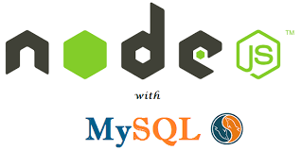
Batch- 10
Hiranya(211FA04589)
NagaSiva(211FA04592)
Sumanth(211FA04593)
Siddardha(211FA04634)

Slide 2
content
Introduction
Why connect Node.js with MySQL?
Connecting node.js with mysql
Updating mysql
Node.js ORM frameworks
Node.js MySQL security
Conclusion

Slide 3

Introduction
Nodejs: Node.js is an open-source, cross-platform JavaScript runtime environment that executes JavaScript code outside of a browser. It is built on Chrome's V8 JavaScript engine and uses an event-driven, non-blocking I/O model that makes it lightweight and efficient.
Node.js is well-suited for developing a wide variety of web applications, including:
Real-time applications, such as chat and streaming apps
Data-intensive applications, such as APIs and microservices
Single-page applications (SPAs)
Command-line tools

Slide 4
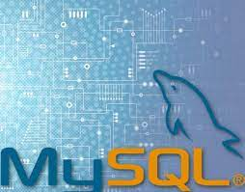
MySQL: MySQL is an open-source relational database management system (RDBMS). It is one of the most popular database systems in the world, and is known for its speed, scalability, and reliability.
MySQL is used by a wide variety of web applications, including:
Content management systems (CMSs), such as WordPress and Drupal
E-commerce platforms, such as Magento and WooCommerce
Social networking sites, such as Facebook and Twitter
Real-time applications, such as chat and streaming apps
Data-intensive applications, such as APIs and microservices

Slide 5
Why connect Node.js with MySQL?
There are many reasons why connecting Node.js with MySQL is a good idea. Some of the most common benefits include:
Performance: Both Node.js and MySQL are known for their speed and efficiency. This makes the combination of Node.js and MySQL ideal for developing high-traffic web applications.
Scalability: Node.js and MySQL are both highly scalable. This means that they can handle a large number of concurrent users without sacrificing performance.
Reliability: Node.js and MySQL are both very reliable. This is important for developing web applications that need to be available 24/7.
Flexibility: Node.js and MySQL can be used to develop a wide variety of web applications, from simple to complex.
Here are some specific examples of how connecting Node.js with MySQL can be beneficial:
Developing real-time applications
Building APIs
Creating microservices
Powering data-intensive applications
Overall, connecting Node.js with MySQL is a good choice for developing a wide variety of web applications, from simple to complex. Node.js and MySQL are both fast, scalable, reliable, and flexible.

Slide 6
Connecting node.js with mysql
To connect Node.js with MySQL, you can use the following steps:
1) Install the MySQL connector for Node.js. You can do this using the following command:
npm install mysql
2) Create a new Node.js file and require the MySQL connector:
const mysql = require('mysql’);
3) Create a connection object to the MySQL database. You can do this by passing in the database host, username, password, and database name to the mysql.createConnection() method:
const connection = mysql.createConnection({
host: 'localhost’,
user: 'root’,
password: 'password’,
database: 'my_database’
});

Slide 7
4) Connect to the MySQL database. You can do this by calling the connect() method on the connection object:
connection.connect(function(err) {
if (err) {
throw err;
}
console.log('Connected to MySQL!’);
});
5) Once you are connected to the MySQL database, you can perform queries and updates. You can do this by calling the query() method on the connection object. The query() method takes a SQL query as its argument and returns a promise that resolves to an array of results or rejects with an error.
For example, the following code will query the users table and return all of the users in the database:
connection.query('SELECT * FROM users', function(err, results) {
if (err) {
throw err;
}
console.log(results);
});

Slide 8
6) When you are finished using the MySQL database, you should close the connection by calling the end() method on the connection object:
connection.end();
Here is a complete example of how to connect Node.js with MySQL and perform a query:
const mysql = require('mysql’);
Const
connection = mysql.createConnection({
host: 'localhost’,
user: 'root’,
password: 'password',
database: 'my_database’
});
connection.connect(function(err) {
if (err) {
throw err;
}
connection.query('SELECT * FROM users', function(err, results) {
if (err) {
throw err;
}
console.log(results);
});
});
connection.end();

Slide 9
Updating mysql
To update a MySQL database from Node.js, you can use the following steps:
1) Connect to the MySQL database using the mqsql.createConnection() method.
2) Create a SQL UPDATE statement. The UPDATE statement should specify the column names that you want to update and the new values for those columns. You can also use the WHERE clause to specify which rows you want to update.
3) Call the query() method on the connection object to execute the UPDATE statement.
4) Check the error object returned by the query() method to make sure that the UPDATE statement was successful.

Slide 10
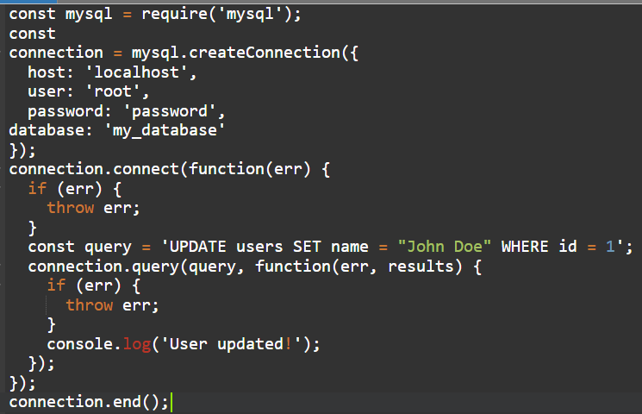
For example, the following code will update the name column of the user with the ID of 1:

Slide 11
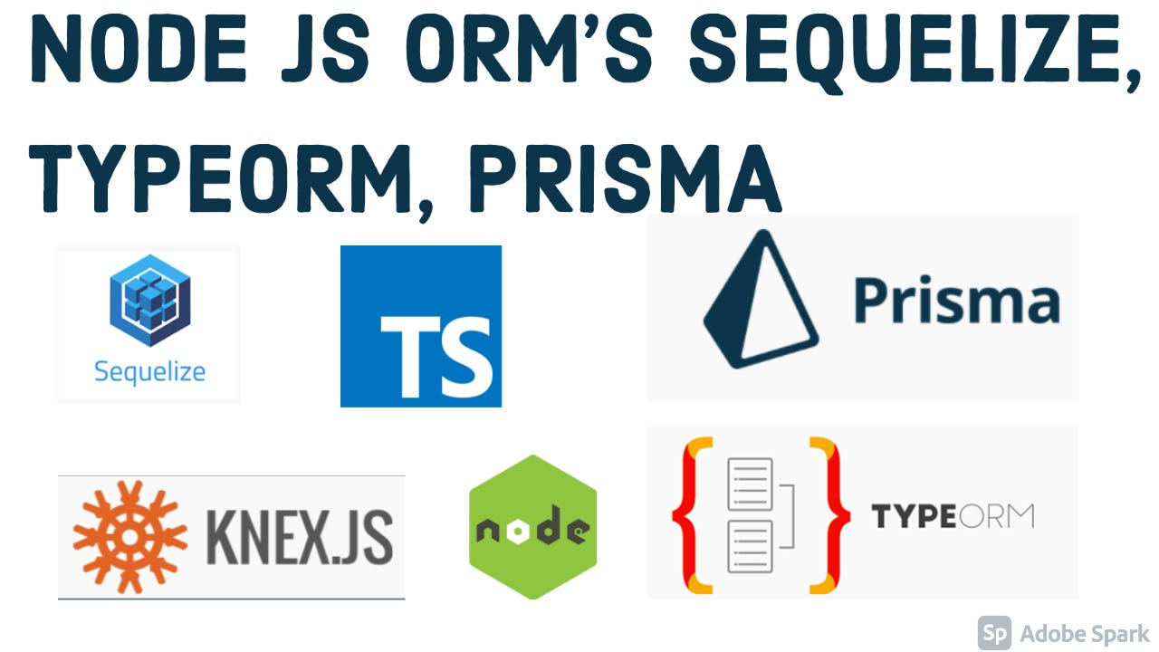
Node.js ORM frameworks
Node.js object-relational mapping (ORM) frameworks make it easier to interact with MySQL from Node.js. ORMs provide a layer of abstraction between your Node.js code and the MySQL database. This makes it easier to write and maintain your Node.js code, and it also makes it easier to switch to a different database system in the future.
Some popular Node.js ORM frameworks include:
Sequelize
Prisma
TypeORM
Objection.js
Mikro-ORM
Here are some of the benefits of using a Node.js ORM framework:
Increased productivity
Improved code quality
Increased portability

Slide 12
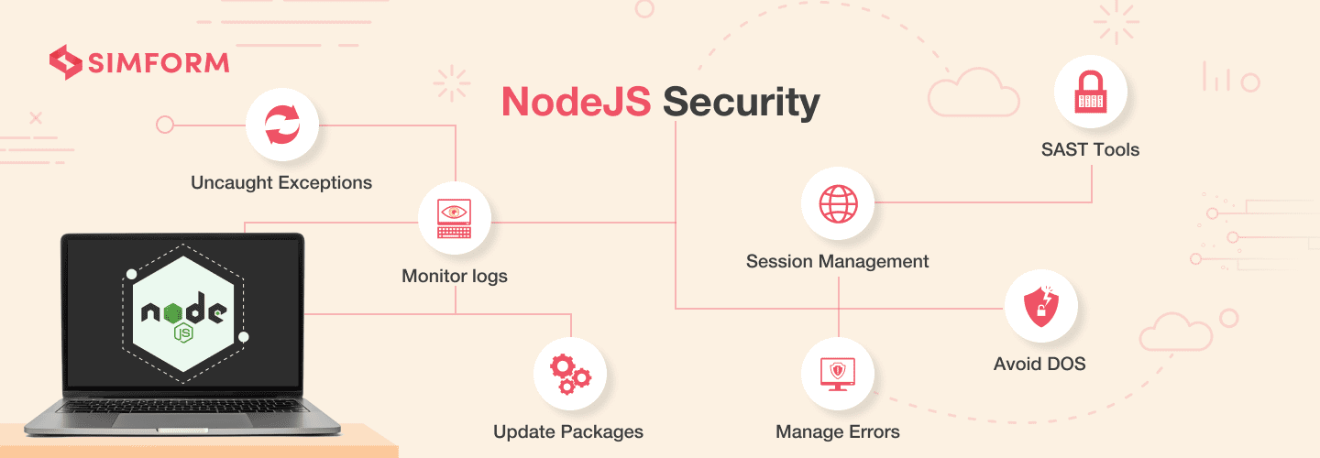
Node.js MySQL security
Node.js MySQL security is important for protecting your database from unauthorized access and attacks. There are a number of things you can do to improve the security of your Node.js MySQL applications, including:
Use strong passwords and encryption
Whitelisting authorized IP addresses
Use prepared statements
Escape user input
Keep your software up to date

Slide 13
conclusion
Node.js MySQL is a powerful combination that can be used to develop fast, scalable, and reliable web applications. By following the tips in this presentation, you can improve the performance, scalability, security, and reliability of your Node.js MySQL applications.
Overall, Node.js MySQL is a good choice for developing high-performance, scalable, and secure web applications.

Slide 14


